Slide 1
Design and Analysis of Algorithms (UE20CS251)
Unit IV - Greedy Technique
Mr. Channa Bankapur
channabankapur@pes.edu

Slide 2
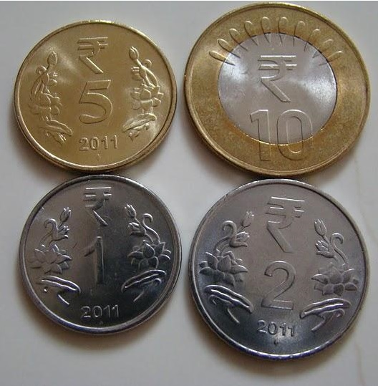
Change-making problem:
How can a given amount of money be made with the least number of coins of given denominations?
Example:
A person buys things worth Rs. 72 and gives a Rs. 100 bill. How does the cashier give change for Rs. 28?

Slide 3
Change-making problem:
How can a given amount of money be made with the least number of coins of given denominations?
Example:
Change for Rs. 28
10 + 18
10 + 10 + 8
10 + 10 + 5 + 3
10 + 10 + 5 + 2 + 1
10 + 10 + 5 + 2 + 1

Slide 4
Suppose the available coin denominations are:
Re. 1, Rs. 2, Rs. 4, Rs. 5, Rs. 10.
Example:
Change for Rs. 28
10 + 18
10 + 10 + 8
10 + 10 + 5 + 3
10 + 10 + 5 + 2 + 1
10 + 10 + 5 + 2 + 1 (5 coins)

Slide 5
Suppose the available coin denominations are:
Re. 1, Rs. 2, Rs. 4, Rs. 5, Rs. 10.
Example:
Change for Rs. 28
10 + 18
10 + 10 + 8
10 + 10 + 5 + 3
10 + 10 + 5 + 2 + 1
10 + 10 + 5 + 2 + 1 (5 coins)
10 + 18
10 + 10 + 8
10 + 10 + 4 + 4
10 + 10 + 4 + 4 (4 coins)

Slide 6
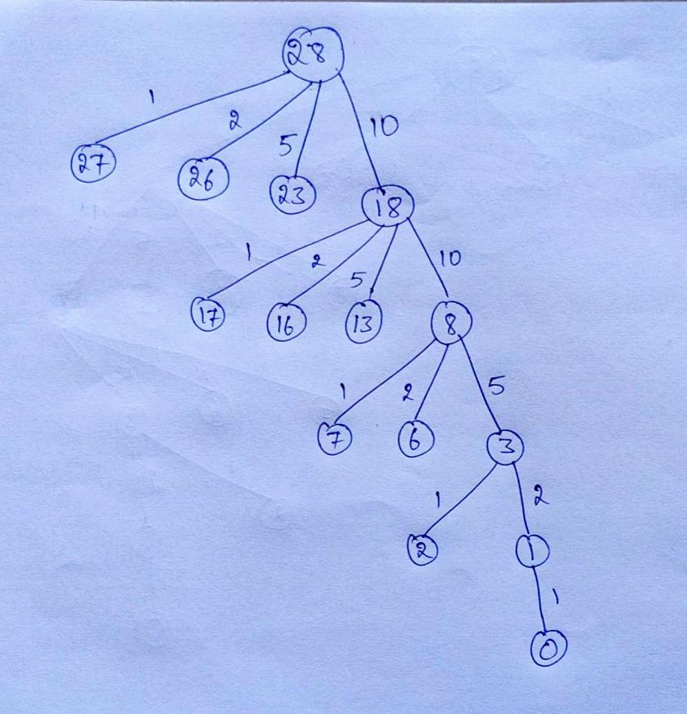
Give change for Rs. 28 using the denominations:
Re. 1
Rs. 2
Rs. 5
Rs. 10.

Slide 7
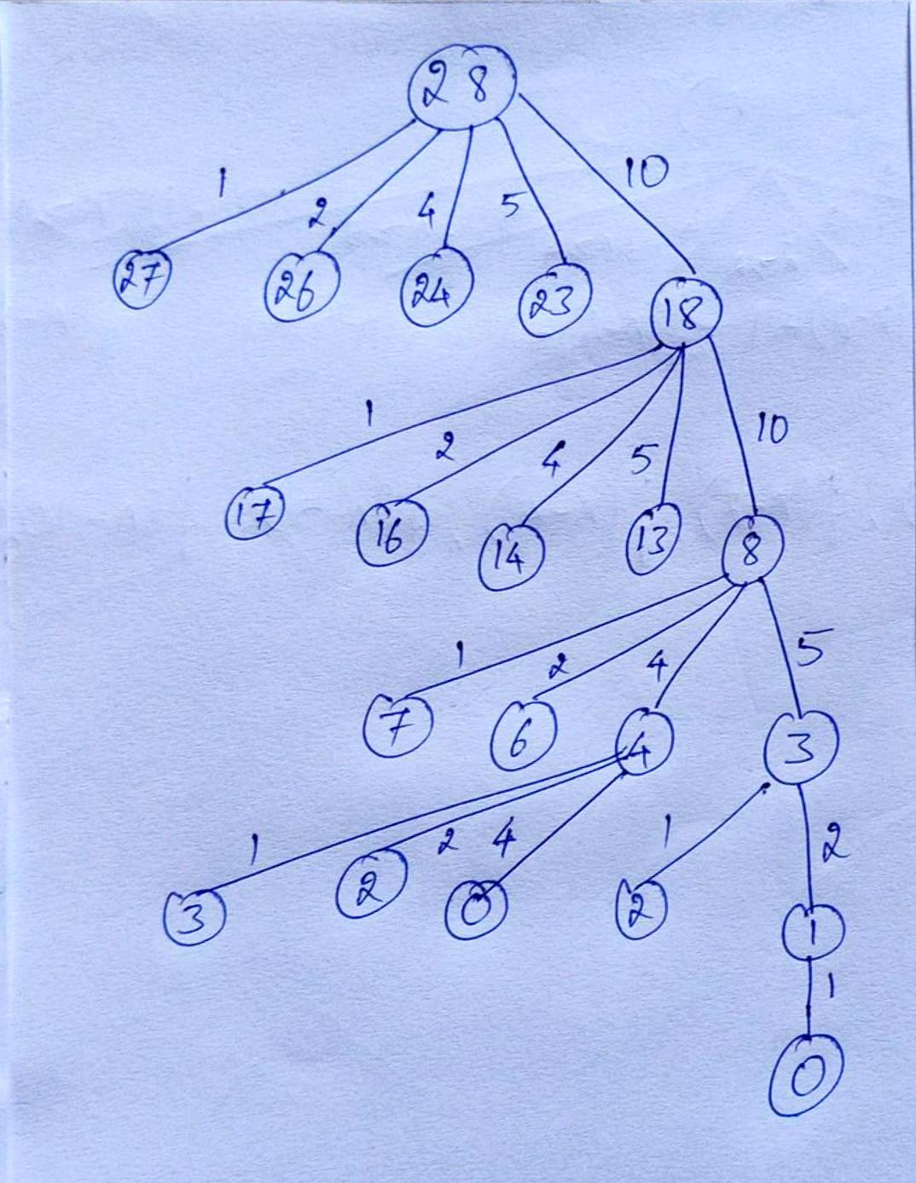
Give change for Rs. 28 using the denominations:
Re. 1
Rs. 2
Rs. 4
Rs. 5
Rs. 10.

Slide 8
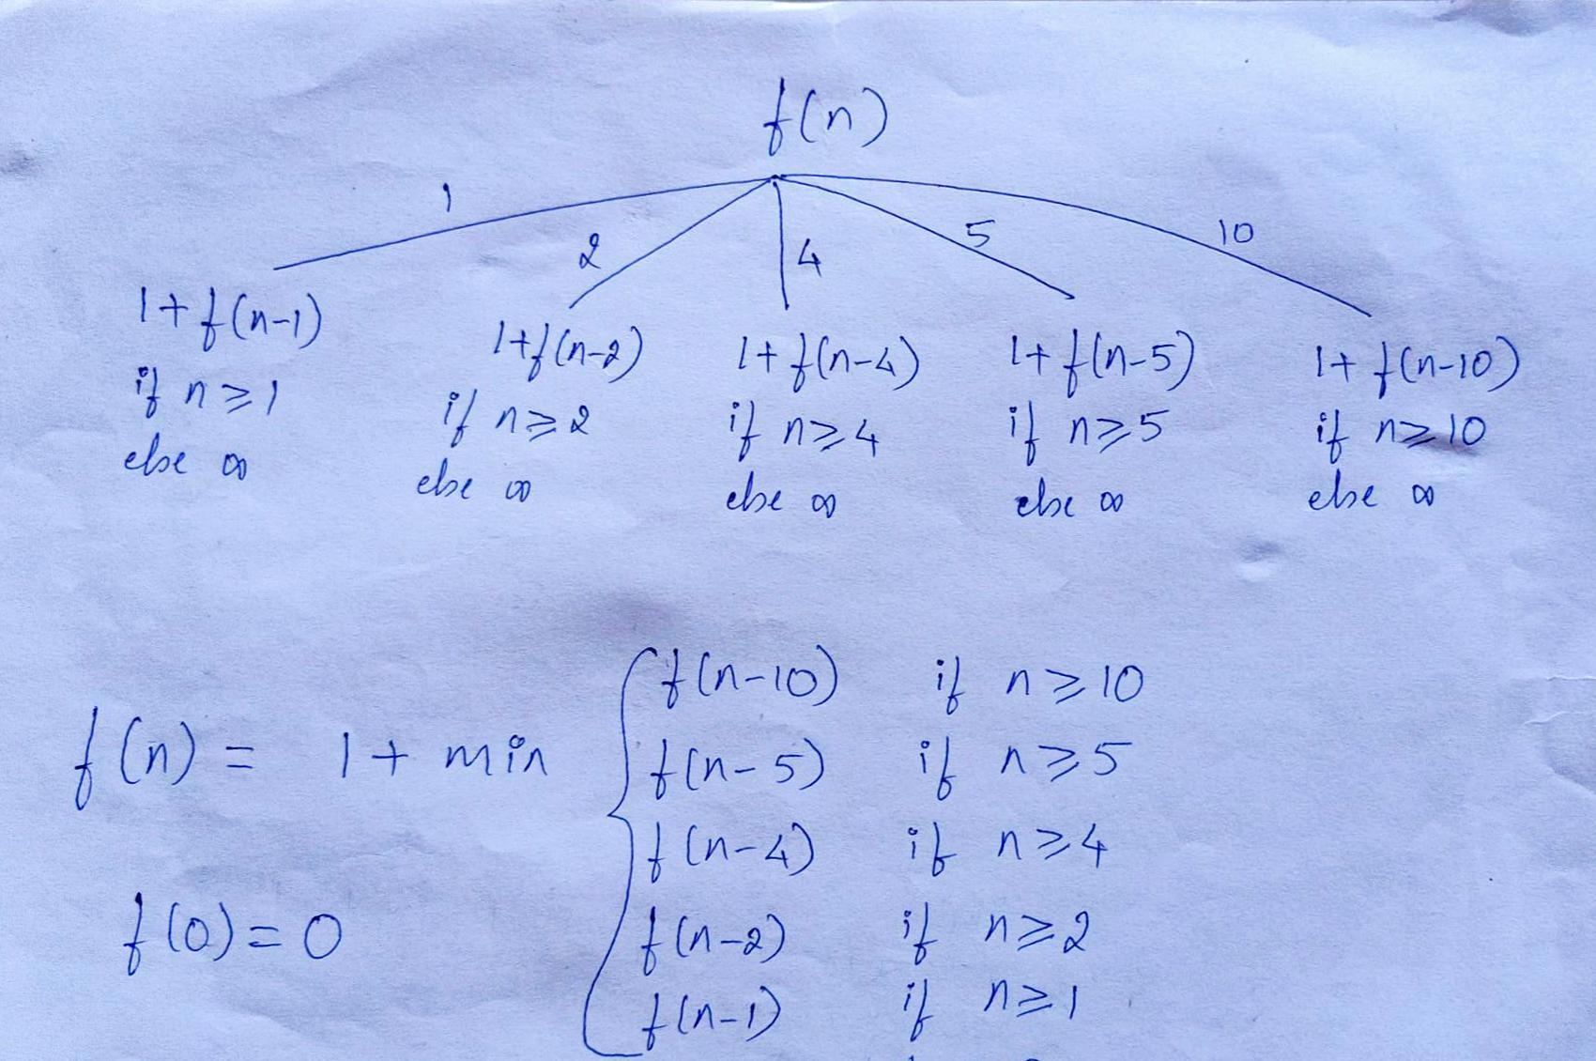
Change-making problem - Exhaustive Approach

Slide 9
Greedy Technique
Locally optimal choices sometimes leads to globally optimal solution.
Greedy choice: Always make a choice that look best at the moment.
Algorithms for optimization problems typically go through a sequence of steps, with a set of choices at each step.
Dynamic Programming solution is an overkill if there is a solution which makes locally optimal choices that leads to globally optimal solution.

Slide 10
Solving an optimization problem using Greedy Technique:
Construct a solution through a sequence of steps.
Each step to expands a partially constructed solution so far, until a complete solution to the problem is reached.
On each step, the choice made must be
Feasible: it has to satisfy the problem’s constraints.
Locally optimal: it has to be the best local choice among all feasible choices available on that step.
Irrevocable: Once made, it cannot be changed on subsequent steps of the algorithm.
Greedy approach gives an optimal solution when globally-optimal solution can be found by a series of local improvements from a starting configuration.

Slide 11
Greedy Approach to solve the TSP problem:
Example:
Graph vertices: A, B, C, D
0 6 5 2
1 0 3 -
5 3 0 3
2 2 7 0

Slide 12
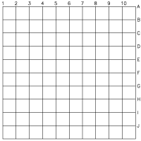
Q: Find the minimum number of moves needed for a chess knight to go from one corner of a 10 × 10 checkerboard to the diagonally opposite corner.
Source cell: (1, 1)
Destination cell: (10, 10)

Slide 13
Q: Find the minimum number of moves needed for a chess knight to go from one corner of a 10 × 10 checkerboard to the diagonally opposite corner.
From (1, 1) to (10, 10)
(3, 2), (4, 4),
(6, 5), (7, 7),
(9, 8), (10, 10)
6 moves (3 sets of moves)
What if it’s a
16 x 16 checkerboard?
8 x 8 checkerboard?

Slide 14
Examples of Greedy Algorithms:
Coin-change problem
Minimum Spanning Tree (MST)
Prim’s Algorithm
Kruskal’s Algorithm
Single-source shortest paths
Dijkstra’s Algorithm
Huffman codes

Slide 15
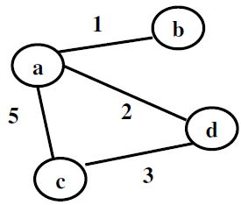
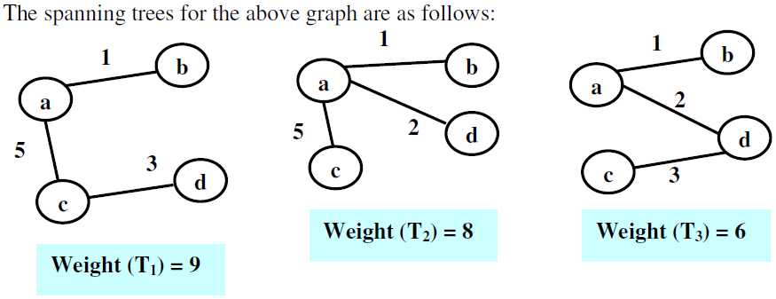
Spanning Tree of a connected graph G is a connected acyclic subgraph (tree) that includes all vertices of G.
Minimum Spanning Tree (MST) of a weighted, connected graph G is a spanning tree of G with minimum total weight.

Slide 16
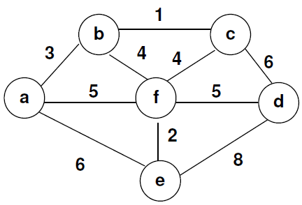
Find Minimum Spanning Tree of the following graph.
Don’t bother about well-known algorithms to the solve the problem at the moment!

Slide 17
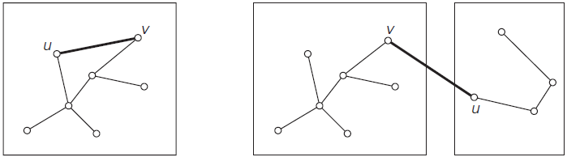
Kruskal’s Algorithm:
Sort the edges of the graph by weight in nondecreasing order.
Start with a forest of n trees, where each tree is single node of the graph.
For i = 1 to n-1 do
Among the edges which are not yet included, select the one with minimum weight that does not form a cycle. This operation merges two trees and hence reduces the number of trees by one.
Return the only tree, which is a minimum spanning tree.

Slide 18
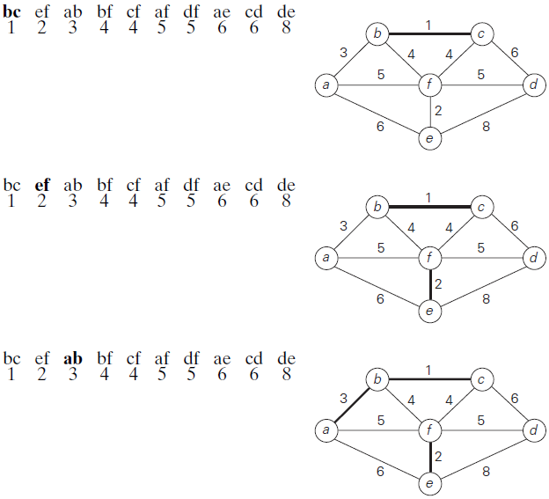

Slide 19
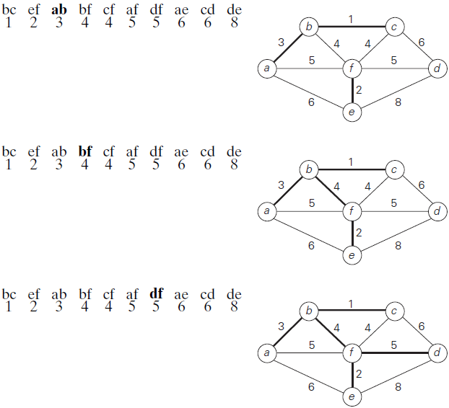

Slide 20
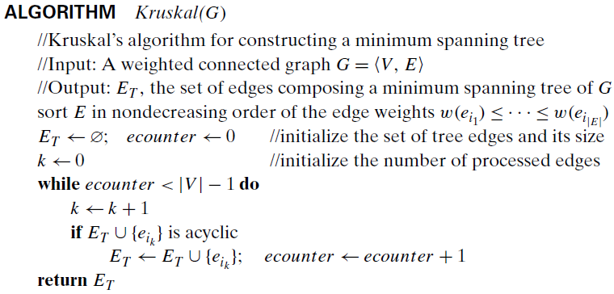
Kruskal’s Algorithm:

Slide 21

Kruskal’s Algorithm:
With an efficient Sorting algorithm and
an Union-Find algorithm.

Slide 22
Prim’s Algorithm:
Start with a tree, T₁, consisting of one vertex.
Adjacent vertices of the vertex in T₁ are “fringe” vertices of T₁.
For i = 2 to n do
Construct T_{i} from T_{i-1} by adding the fringe vertex with the minimum weight edge from the set. The vertex is removed from the set of fringe vertices.
Add the adjacent vertices of the vertex to the set of fringe vertices which are not in T_{i}.
Remove vertices from the set of fringe vertices where the new vertex is one of the terminal vertex of the edge.
Return T_{n} which is a minimum spanning tree.

Slide 23
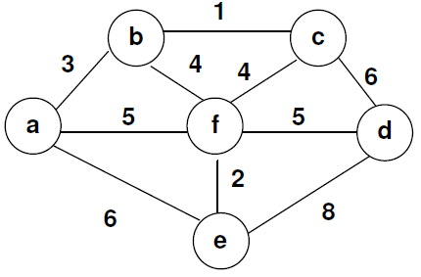
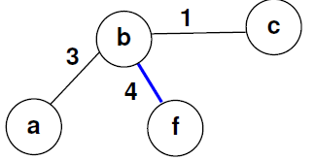
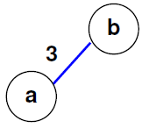
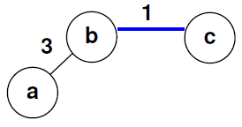
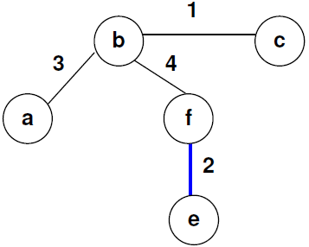
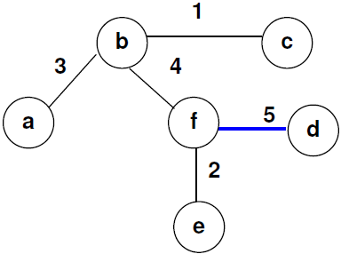
Prim’s Algorithm:

Slide 24
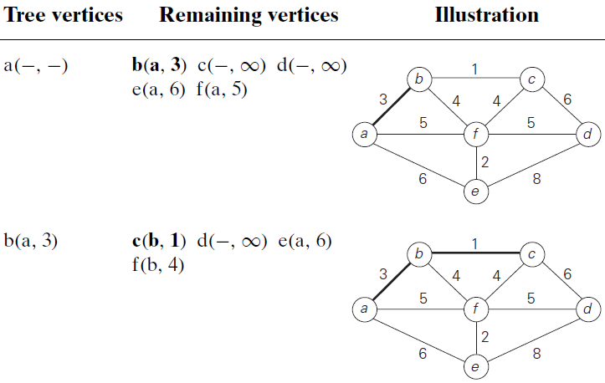
Prim’s Algorithm:

Slide 25
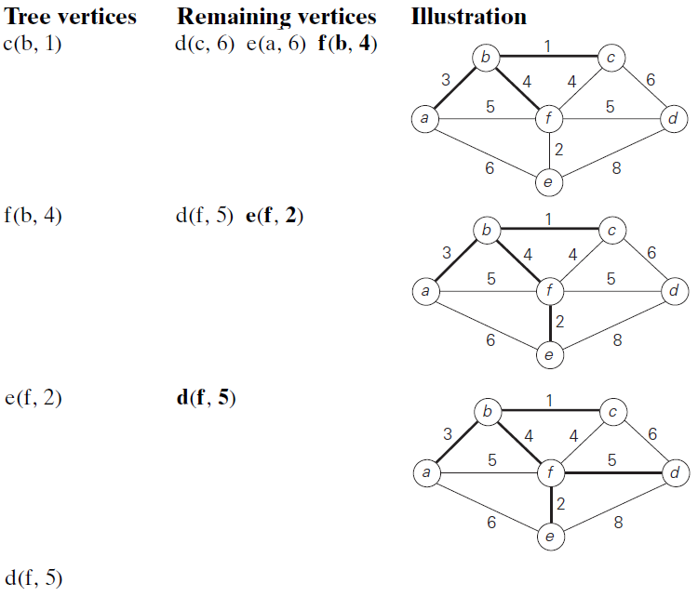

Slide 26
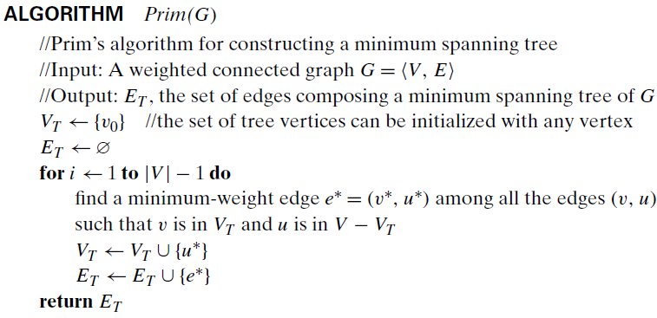
Prim’s Algorithm:

Slide 27
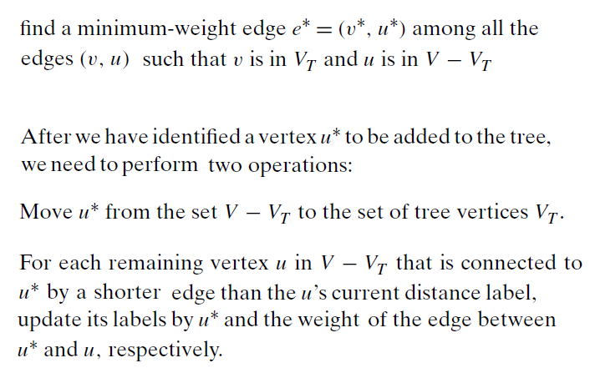
Prim’s Algorithm:

Slide 28
The set V - V^{T} is a priority queue and could be represented as a min-heap.
First operation is, extracting min valued element from the heap and hence takes O(log|V|) time. As it is executed for |V|-1 times, the operation overall takes O(|V| log|V|) time.
Second operation is, for each adjacent vertex of u*, which is in V-V^{T}. It may try to decrease the value of the key in the heap, which takes O(log|V|) time. The outer loop runs for |V|-1 times (that is, for each vertex u*) and the inner loop runs for each adjacent vertex of u*. Put together the "Decrease Key" operation runs once for each edge of the graph. That's why it is O(|E|log|V|) time.
Running time = O(|V| log|V|) + O(|E| log|V|)
= O((|E|)log|V|) since, |E| >= |V|-1 for a connected graph.

Slide 29
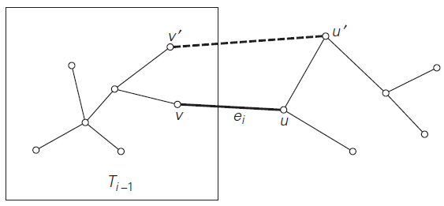

Slide 30
Dijkstra’s Algorithm:
Solves single-source shortest-paths problem.
Problem: For a given vertex called the source in a weighted connected graph, find the shortest paths to all the other vertices.
A family of paths each leading from the source to a different vertex in the graph. Some paths may have a common prefix. If a shortest path from the source to a vertex ‘b’ goes through a vertex ‘a’, then the shortest path from the source to the vertex ‘a’ is the same path until the vertex ‘a’.

Slide 31
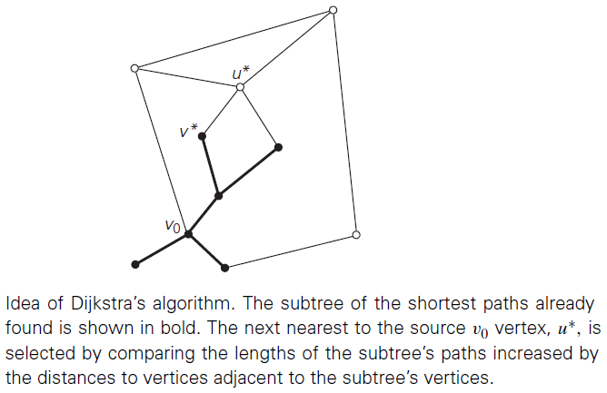
Dijkstra’s Algorithm:

Slide 32
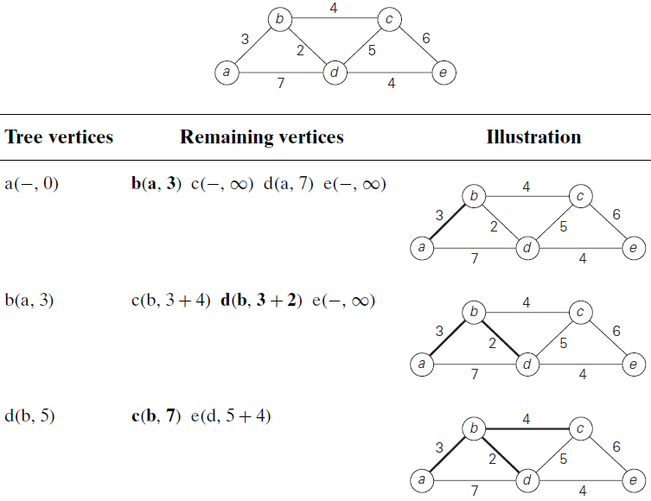

Slide 33
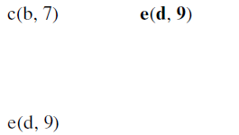
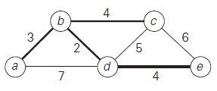
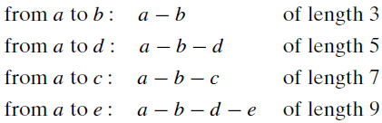

Slide 34
Dijkstra’s Algorithm:
First, it finds the shortest path from the source to a vertex nearest to it, then to the second nearest, and so on.
The algorithm finds the shortest paths to the graph’s vertices in order of their shortest distance from the source vertex.
All the vertices including the source, and the edges of the shortest paths leading to them from the source form a tree, which is a subgraph of the given graph.
The algorithm is applicable to undirected and directed graphs with nonnegative weights only.

Slide 35
Dijkstra’s Algorithm:
The set of vertices not in Ti, which are adjacent to the vertices in Ti can be referred to as “fringe vertices”; they are the candidates from which Dijkstra’s algorithm selects the next vertex nearest to the source.
To identify the i^{th} nearest vertex, the algorithm computes, for every fringe vertex u, the shortest distance from the adjacent vertices in Ti and then selects the vertex with the smallest such distances. (This selection is the greedy step!)
Why is this locally optimal choice is part of a globally optimal solution?

Slide 36
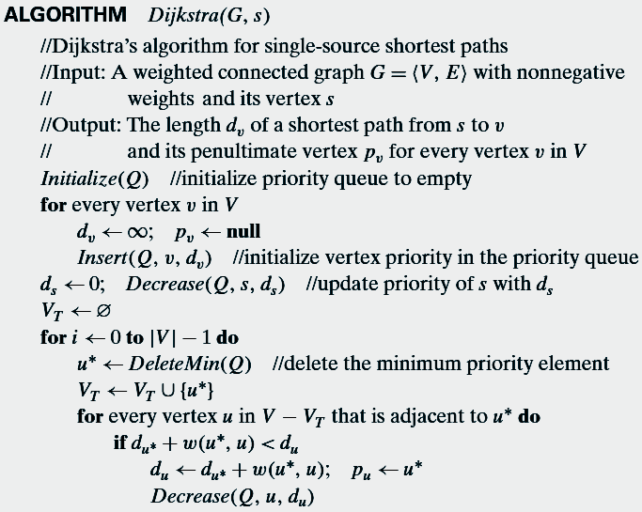

Slide 37
Dijkstra’s Algorithm:
After we have identified a vertex u∗ to be added to the tree, we need to perform two operations:
Move u∗ from the fringe to the set of tree vertices.
For each remaining fringe vertex u that is connected to u∗ by an edge of weight w(u∗, u) such that d_{u∗}+ w(u∗,u) < d_{u}, update the labels of u by u∗ and d_{u∗} + w(u∗, u), respectively.

Slide 38
Dijkstra’s Algorithm:
Time Complexity:
O(n²)
where n is the number of vertices
Graph is represented as weight matrix
Priority Queue is implemented as an unordered array
O(m log n)
where m and n are the number of edges and vertices, respectively.
Graph is represented as adjacency lists
Priority Queue is implemented as a min-heap

Slide 39
Huffman Trees and Codes:
Codeword: Encoding a text that comprises n characters from some alphabet by assigning to each of the text’s characters some sequence of bits. This bit-sequence is called codeword.
Fixed length encoding: Assigns to each character a bit string of the same length.
Variable length encoding: Assigns codewords of different lengths to different characters.
Prefix free code: In Prefix free code, no codeword is a prefix of a codeword of another character.

Slide 40
Huffman Trees and Codes:
Binary prefix code :
The characters are associated with the leaves of a binary tree.
All left edges are labeled as 0, and right edges as 1.
Codeword of a character is obtained by recording the labels on the simple path from the root to the character’s leaf.
Since, there is no simple path to a leaf that continues to another leaf, no codeword can be a prefix of another codeword.

Slide 41
About Huffman Algorithm:
Invented by David A Huffman in 1951.
Constructs binary prefix code tree.
Huffman’s algorithm achieves data compression by finding the best variable length binary encoding scheme for the symbols that occur in the file to be compressed. Huffman coding uses frequencies of the symbols in the string to build a variable rate prefix code
Each symbol is mapped to a binary string
More frequent symbols have shorter codes
No code is a prefix of another code (prefix free code)
Huffman Codes for data compression achieves 20-90% Compression.

Slide 42
Huffman Algorithm:
Input: Alphabet and frequency of each symbol in the text.
Step 1: Initialize n one-node trees (forest) and label them with the symbols of the alphabet given. Record the frequency of each symbol in its tree’s root to indicate the tree’s weight. (Generally, the weight of a tree will be equal to the sum of the frequencies in the tree’s leaves.)
Step 2: Repeat the following operation until a single tree is obtained. Find two trees with the smallest weight. Make them the left and right subtree of a new tree and record the sum of their weights in the root of the new tree as its weight.

Slide 43

Huffman Algorithm:

Slide 44
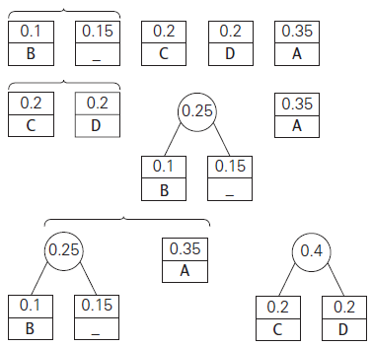
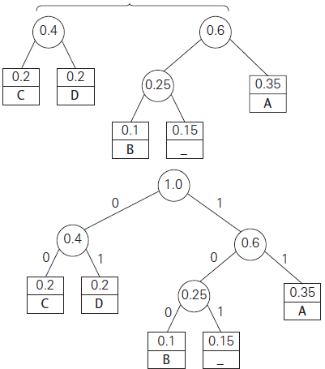
Huffman Algorithm:

Slide 45

Huffman Algorithm:

Slide 46

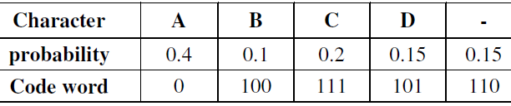
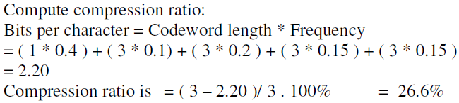
Huffman Algorithm:

Slide 47
Huffman Coding:
Optimal Encoding: When the frequencies of symbol occurrences are independent and known in advance, the Huffman Algorithm yields an optimal, i.e., minimal-length, encoding.
Drawback: It is necessary to include the coding table into the encoded text to make its decoding possible.
Lempel-Ziv algorithm: assign codewords not to individual symbols but to strings of symbols, allowing them to achieve better and more robust compressions in many applications.

Slide 48
Q: For the given alphabet and their frequencies in a text, write
Huffman tree
Huffman codes
Encode the text: A_CAB_AB_AD
Decode the code string:
Alphabet: A B C D _
Frequencies: 45 17 2 1 35

Slide 49
Q: For the given alphabet and their frequencies in a text, write
Huffman tree
Huffman codes
Encode the text: A_CAB_AB_AD
Decode the code string:
Alphabet: A B C D _
Frequencies: 45 17 2 1 35
Codes: 0 100 1010 1011 11
A_CAB_AB_AD: 011101001001101001101011
011101001001101001101011: A_CAB_AB_AD
BAD_CAB: 100010111110100100

Slide 50
Greed is good when it’s a good greed!
</ End of Greedy Technique >

